Slide 1
Machine Learning CS601PC Chapter 11. Analytical Learning
ASHA
ECE DEPT
KMIT

Slide 2
CONTENTS
INTRODUCTON
LEARNING WITH PERFECT DOMAIN THOERIES:PROLOG-EBG
REMARKS ON EXPLANATION BASED LEARNING
EXPLNANTION BASED LEARNING OF SEARCH CONTROL KNOWLEDGE
SUMMARY

Slide 3
Overview
As discussed earlier, inductive learning methods require a certain number of training examples to generalize accurately.
Analytical learning stems from the idea that when not enough training examples are provided, it may be possible to “replace” the “missing” examples by prior knowledge and deductive reasoning.
Explanation-Based Learning is a particular type of analytical approach which uses prior knowledge to distinguish the relevant features of the training examples from the irrelevant, so that examples can be generalized based on logical rather than statistical reasoning.

Slide 4
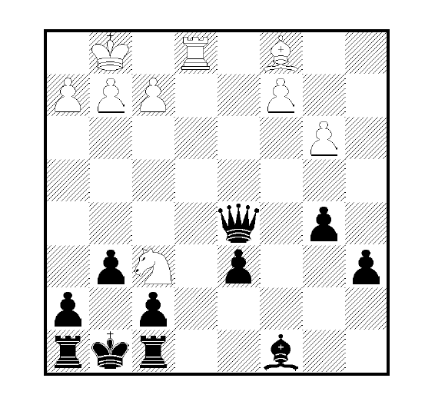
A POSITIVE EXAMPLE

Slide 5
Intuition about Explanation-Based Learning I
Figure 11.1 of [Mitchell, p.308] represents a positive example of the target concept: “chess position in which black will lose its queen within two moves”.
Inductive learning could eventually learn this concept with a large number (thousands?) of such examples.
However, that is not what human beings do: they learn from a restricted number of examples: they can even learn quite a lot from the single example in Figure 11.1.

Slide 6
Intuition about Explanation-Based Learning II
From the single board on Figure 11.1, humans can suggest the general hypothesis: “board positions in which the black king and queen are simultaneously attacked”. They would not even consider the (equally consistent) hypothesis “board positions in which four white pawns are still in their original position”!
They do so, because they rely heavily on explaining or analyzing the example in terms of their prior knowledge about the legal moves of chess.
Explanation-Based-Learning attempts to learn in the same fashion.

Slide 7
Analytical Learning: A Definition
Given a hypothesis space H a set of training examples D and a domain theory B consisting of background knowledge that can be used to explain observed training examples, the desired output of an analytical learner is a hypothesis h from H that is consistent with both the training examples D and the domain theory B.
Explanation-Based-Learning works by generalizing not from the training examples themselves, but from their explanation.

Slide 8
OUTLINE
Two formulations for learning: Inductive and Analytical
Perfect domain theories and Prolog-EBG

Slide 9
Learning with Perfect Domain Theories: Prolog-EBG
Prolog-EBG(TargetConcept, TrainingExamples, DomainTheory)
LearnedRules <-- { }
Pos <-- the positive examples from TrainingExamples
for each PositiveExample in Pos that is not covered by LearnedRules, do
1. Explain: Explanation <-- an explanation (proof) in terms of the DomainTheory that PositiveExample satisfies the TargetConcept
2. Analyze: SufficientConditions <-- the most general set of features of PositiveExample sufficient to satisfy the TargetConcept according to the Explanation
3. Refine: LearnedRules <-- LearnedRules + NewHornClause, where NewHornClause is of the form:
TargetConcept <-- SufficientConditions
Return LearnedRules

Slide 10
The Inductive Generalization Problem
Given:
Instances
Hypotheses
Target Concept
Training examples of target concept
Determine:
Hypotheses consistent with the training examples

Slide 11
The Analytical Generalization Problem(Cont’)
Given:
Instances
Hypotheses
Target Concept
Training examples of target concept
Domain theory for explaining examples
Determine:
Hypotheses consistent with the training examples and the domain theory

Slide 12
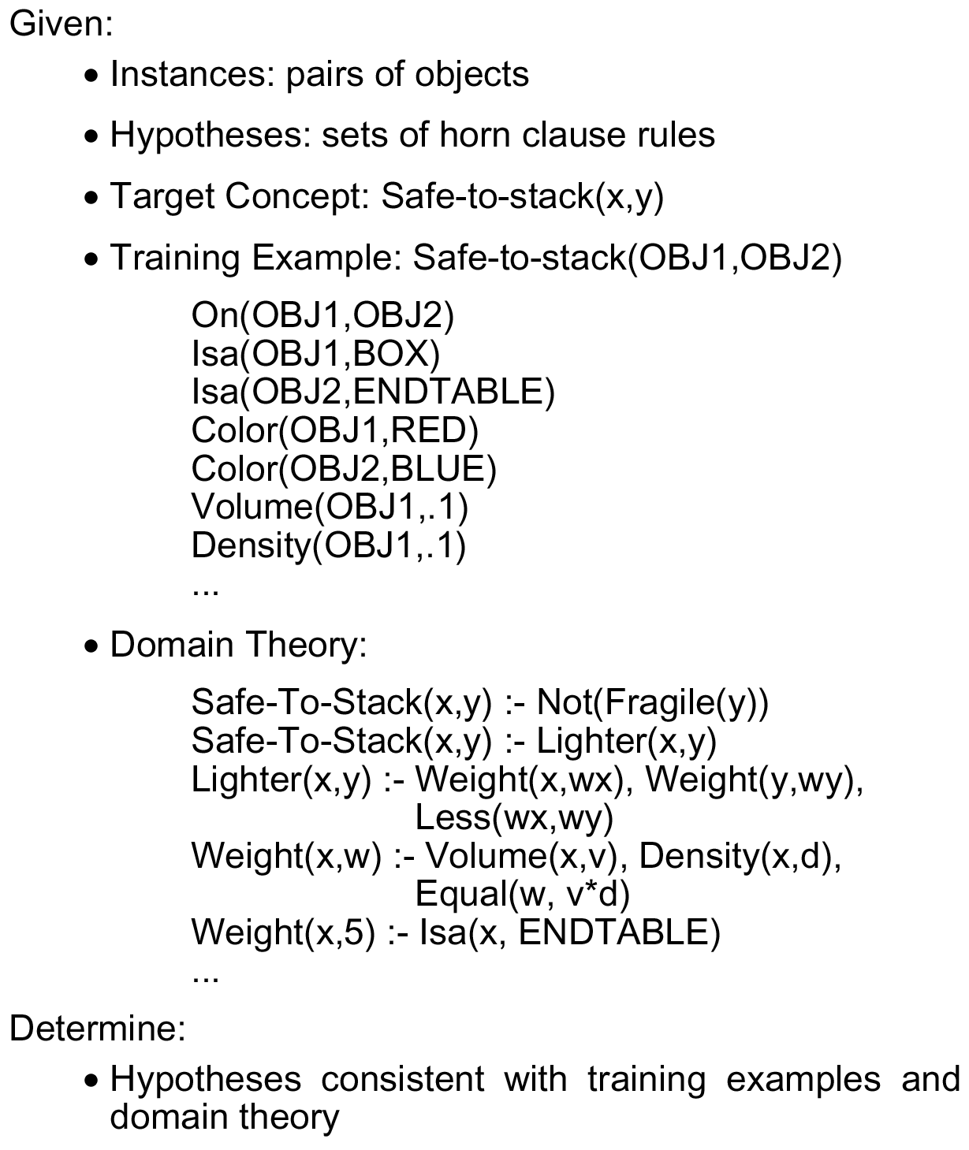
An Analytical Generalization Problem

Slide 13
Learning from Perfect Domain Theories
Assumes domain theory is correct (error-free)
Prolog-EBG is algorithm that works under this assumption
This assumption holds in chess and other search problems
Allows us to assume explanation = proof
Later we’ll discuss methods that assume approximate domain theories

Slide 14
Prolog EBG
Initialize hypothesis = {}
For each positive training example not covered by hypothesis:
1. Explain how training example satisfies target concept, in terms of domain theory
2. Analyze the explanation to determine the most general conditions under which this explanation (proof) holds
3. Refine the hypothesis by adding a new rule, whose preconditions are the above conditions, and whose consequent asserts the target concept

Slide 15
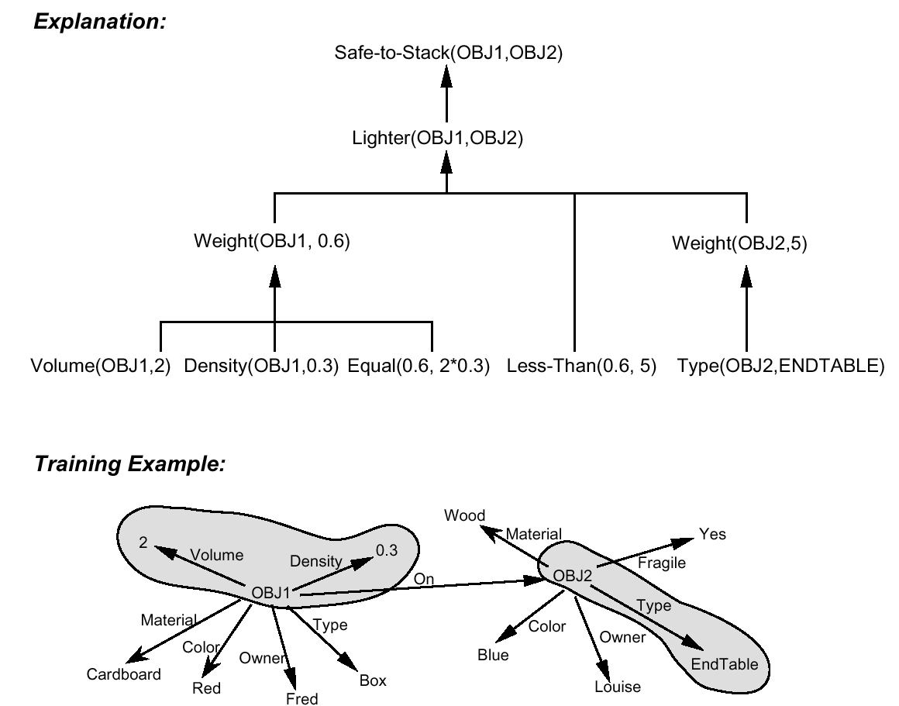
Explanation of a Training Example

Slide 16
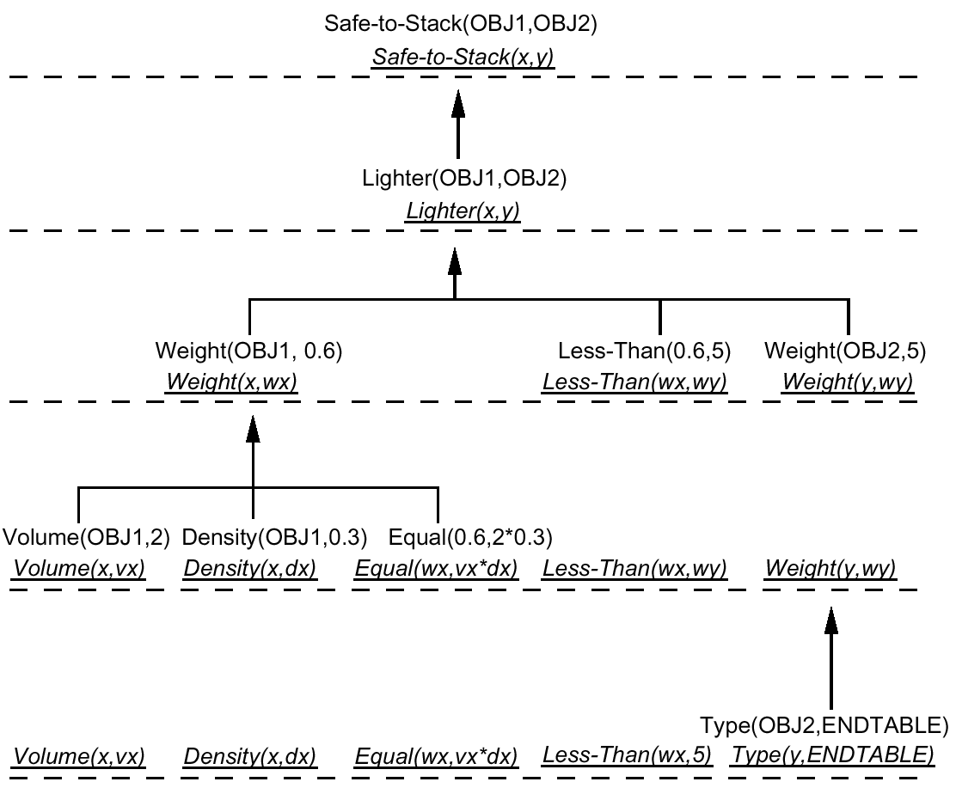
Computing the Weakest Preimage of Explanation

Slide 17
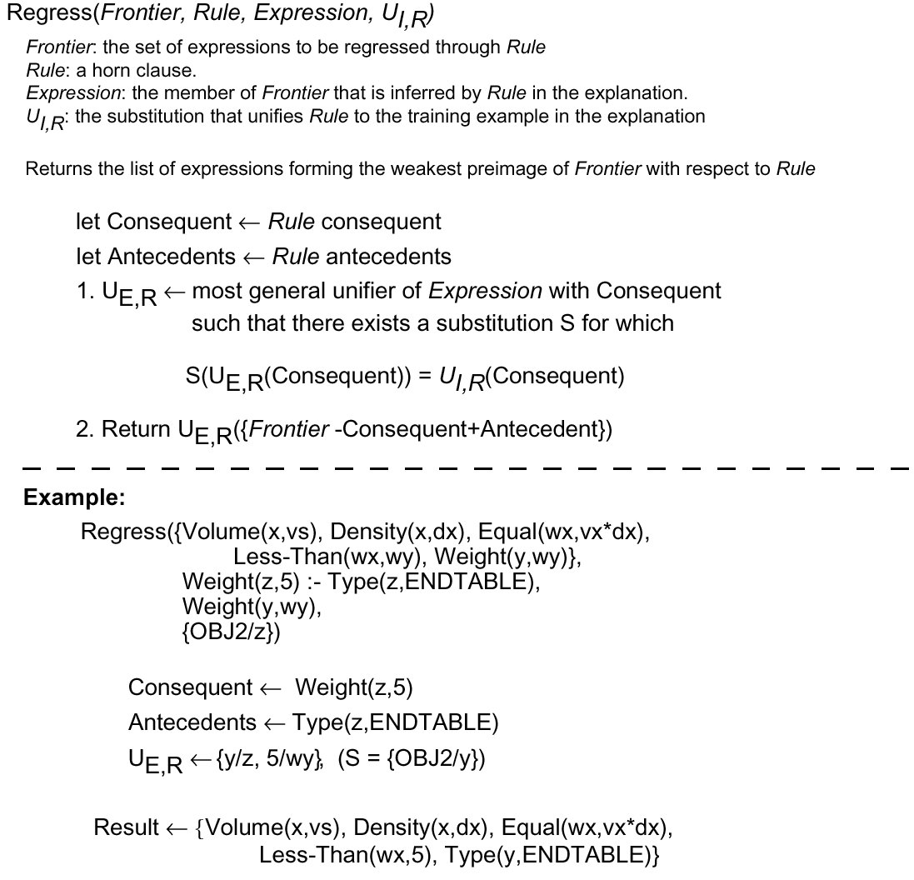
Regression Algorithm

Slide 18
Lessons from Safe-to-Stack Example
Justified generalization from single example
Explanation determines feature relevance
Regression determines needed feature constraints
Generality of result depends on domain theory
Still require multiple examples

Slide 19
Perspectives on Prolog-EBG
Theory-guided generalization from examples
Example-guided operationalization of theories
"Just" restating what learner already "knows“
Is it learning?
Are you learning when you get better over time at chess?
Even though you already know everything in principle, once you know rules of the game...
Are you learning when you sit in a mathematics class?
Even though those theorems follow deductively from the axioms you’ve already learned...

Slide 20
Different Perspectives on Explanation-Based-Learning (EBL)
EBL as theory-guided generalization of examples: EBL generalizes rationally from examples.
EBL as example-guided reformulation of theories: EBL can be viewed as a method for reformulating the domain theory into a more operational form.
EBL as “just” restating what the learner already knows: EBL proceeds by reformulating knowledge and this can sometimes be seen as an important kind of learning (the difference between knowing how to play chess and knowing how to play chess well, for example!)

Slide 21
EBL of Search Control Knowledge
Given EBL’s restriction to domains with a correct and complete domain theory, an important class of application is in speeding up complex search problems by learning how to control search.
Two well-known systems employ EBL in such a way: PRODIGY and SOAR.
In PRODIGY, the questions that need to be answered during the search problem are: “Which subgoals should be solved next?” and “Which operator should be considered for solving this subgoal?”. PRODIGY learns concepts such as “the set of states in which subgoal A should be solved before subgoal B”.

Slide 22
EBL of Search Control Knowledge
SOAR learns by explaining situations in which its current strategy leads to inefficiencies. More generally, SOAR uses a variant of EBL called chunking to extract the general conditions under which the same explanation applies.
SOAR has been applied in a great number of problem domain and has also been proposed as a psychologically plausible model of human learning processes.

Slide 23
Problems associated with applying EBL to Learning Search Control
In many cases, the number of control rules that must be learned is very large. As the system learns more and more control rules to improve its search, it must pay a larger and larger cost at each step to match this set of rules against the current search state.
In many cases, it is intractable to construct the explanations for the desired target concept.

Slide 24
Summary of Prolog-EBG
Prolog-EBG produces justified general hypotheses.
The explanation of how the examples satisfy the target concept determines which examples attributes are relevant: those mentioned in the explanation.
Regressing the target concept to determine its weakest preimage allows deriving more general constraints on the value of the relevant features.
Each learned Horn Clause corresponds to a sufficient condition for satisfying the target concept.
The generality of the learned Horn clauses depend on the formulation of the domain theory and on the sequence in which the training data are presented.
Prolog-EBG implicitly assumes that the domain theory is correct and complete.

